Slide 1



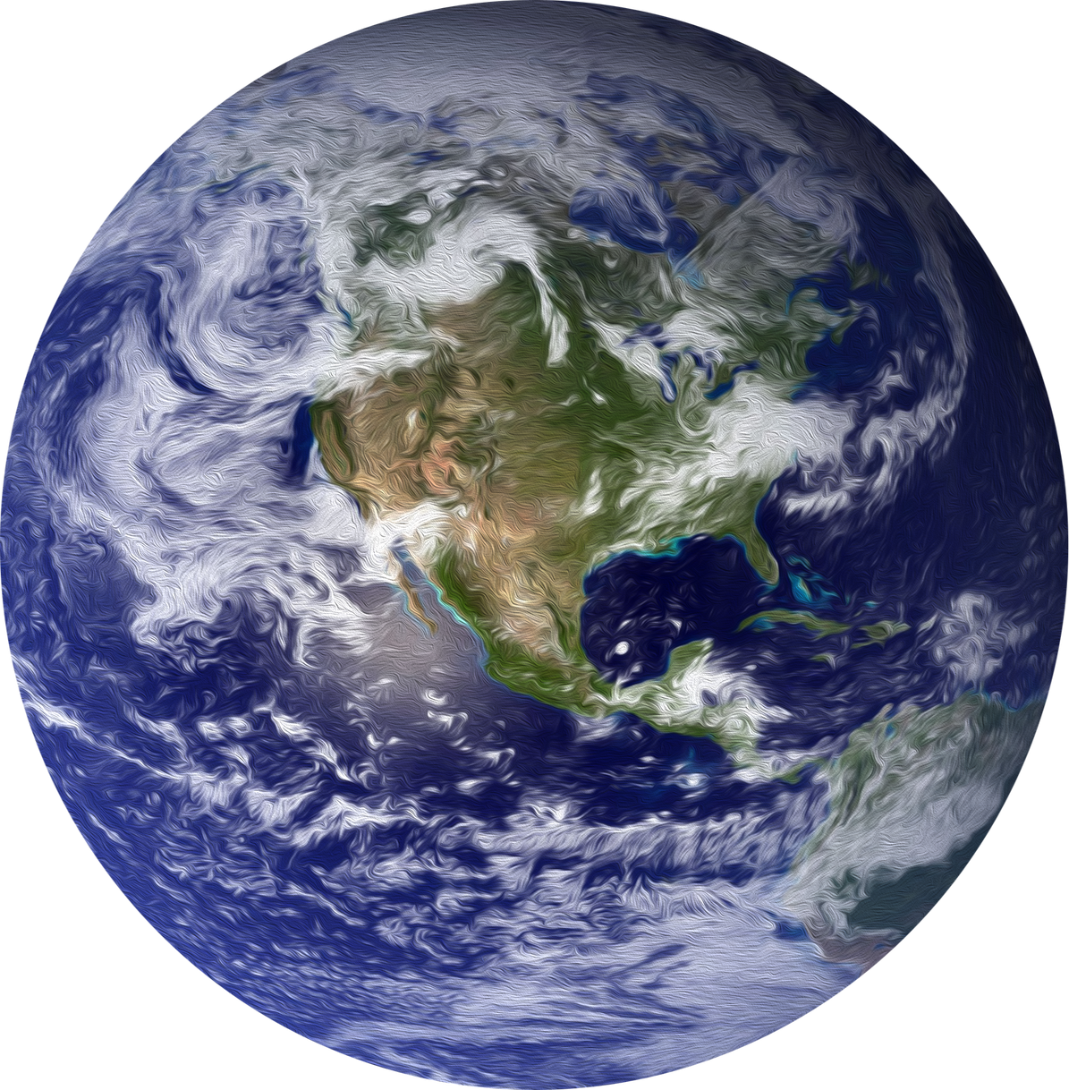
COSMORA EXOPLANET CLASSIFIER
Team Members:
Aahana
Inaya
Swasti
Rushabh
Prisha
Suzen

Slide 2

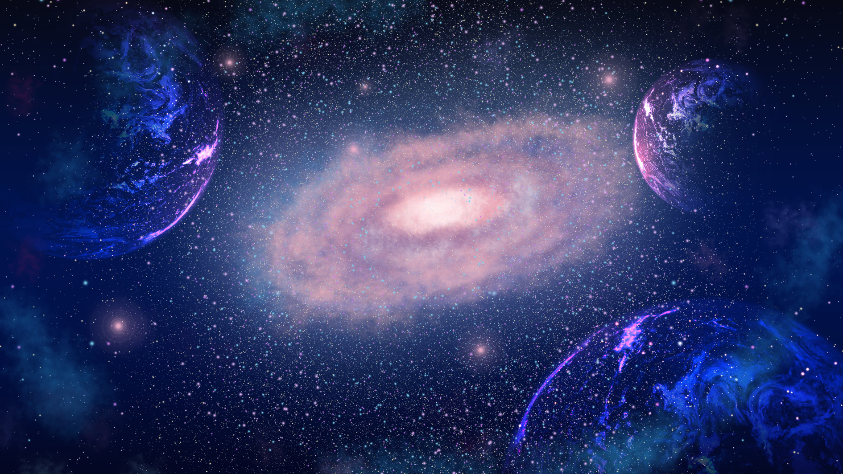
What’s the Problem?
Kepler & TESS missions have generated enormous datasets.
Kepler: 530,506 stars observed
TESS: >26,000 exoplanet candidates (only ~4000 confirmed so far)
Confirming exoplanets is slow.
Astronomers spend valuable time on data cleaning & manual analysis.

Slide 3
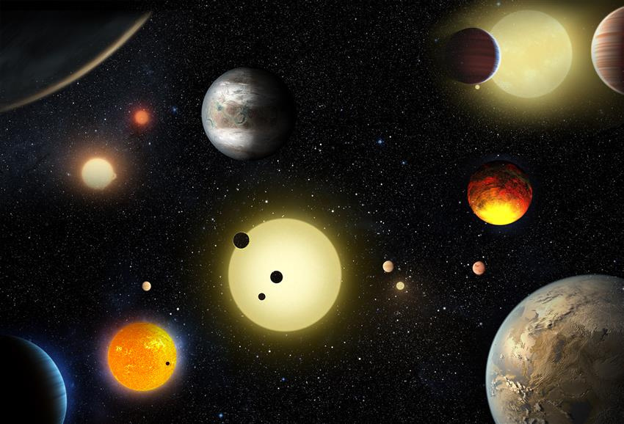
Our Solution!
We created a machine learning model (that we trained on NASA’s Kepler Object of Interest dataset) that reduces these manual efforts. Our model is 73% accurate and allows users to input their own data, allowing them to classify exoplanets as confirmed, candidate or false positives.

Slide 4
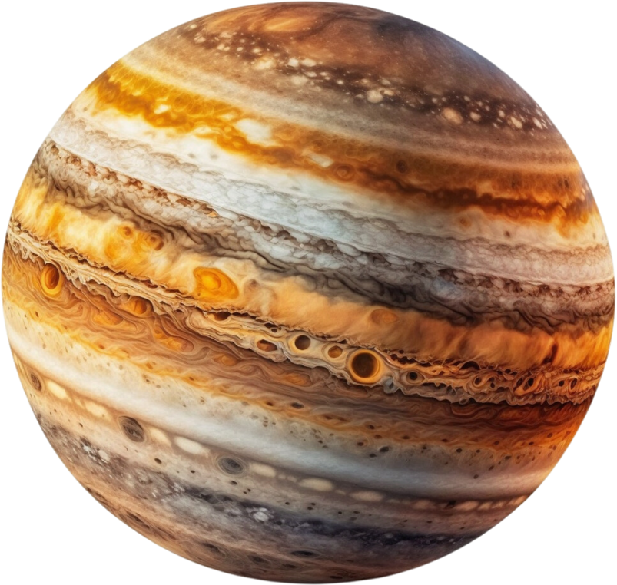
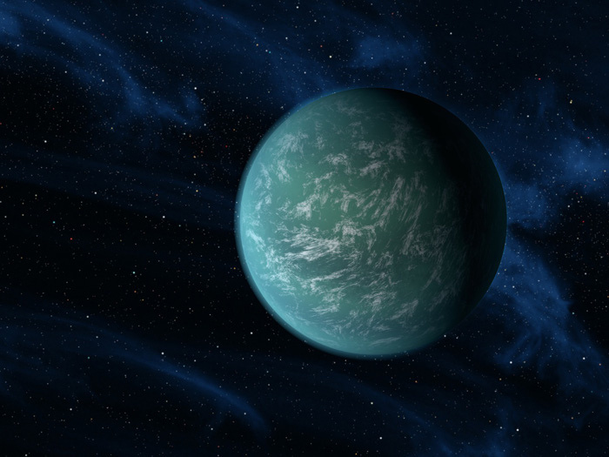
How this could help?
Saves time for researchers
Makes NASA’s open data more accessable and easy to understand.
01
02
Can be used by students all around the world.
03

Slide 5

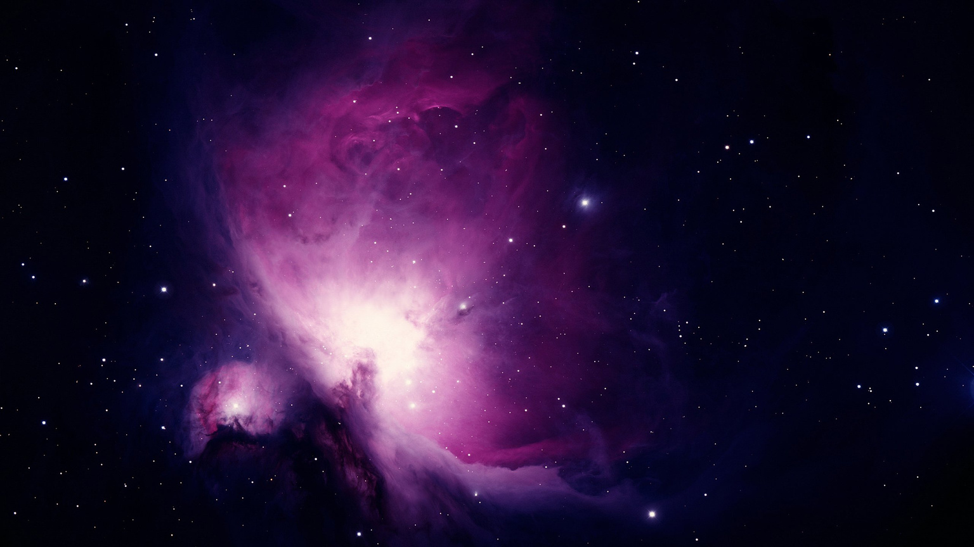
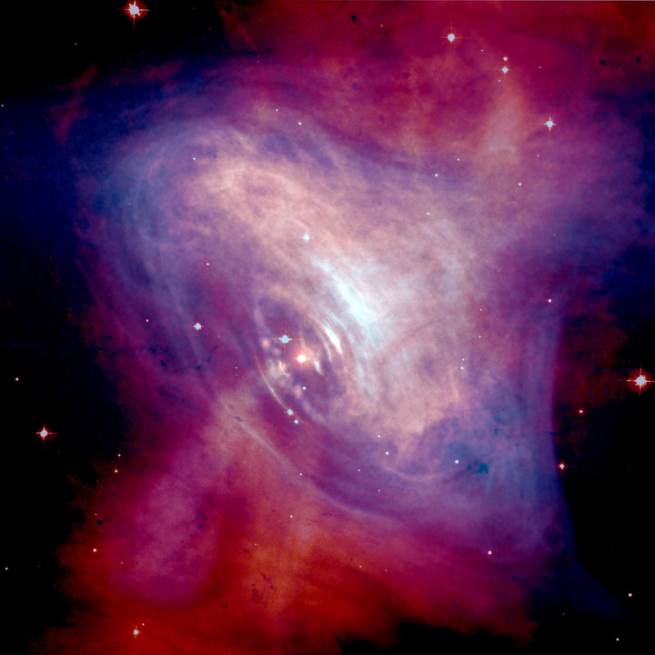
What makes ours unique?
It is based on machine learning algorithms, particularly on Gradient Boosting Classifiers.
01
Along with classification, the system generates a planet description, transit light curve, and AI image of the exoplanet
02
03
It has a very user-friendly interface

Slide 6
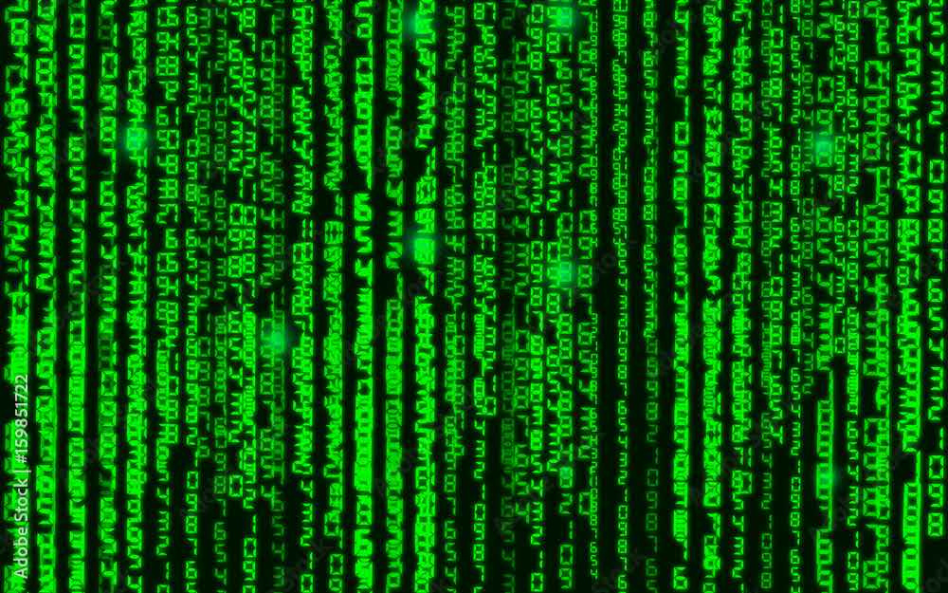
Tech Stack
Programming Languages & Libraries
Python – Core logic, data processing, machine learning, API calls
SQL / CSV – Storing and reading exoplanet dataset
APIs / Cloud Services
Azure OpenAI API – Image generation requests from Python
Other Tools
Command Prompt / Terminal – Running Streamlit and importing modules
Jupyter Notebook / VS Code – Development and testing
Git / GitHub (optional) – Version control
Data
NASA’S Kepler Object of Interest Dataset

Slide 7
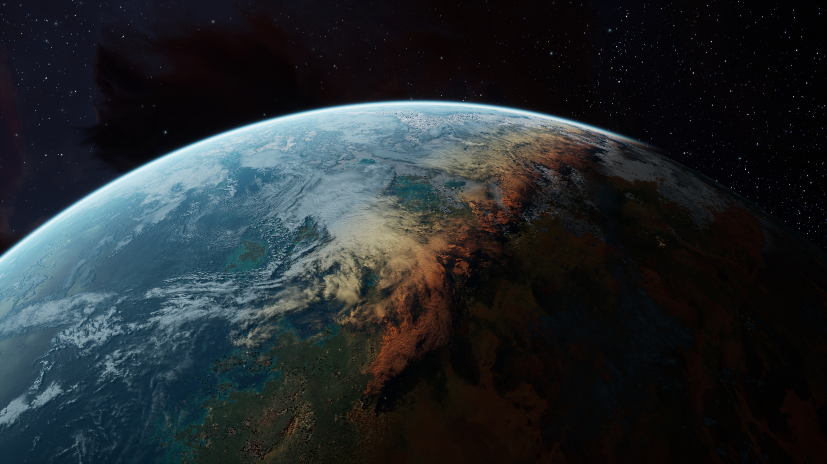
Thank You!

